Slide 1
0 Introduction
1 Social choice
2 Externalities and public goods
3 Decision analysis
4 Valuation: Aims and purpose
5 Valuation: Revealed preferences
6 Valuation: Stated preferences
7 Direct regulation
8 Market-based instruments
9 Complications with instruments
10 Growth and the environment
11 Green accounting

Slide 2
EnvEcon1 – Social choice
Ethical foundations of social choice
Sustainability

Slide 3
Why Ethics?
Environmental economics is about the allocation, distribution and use of environmental resources
Environmental economics is part of public economics, the economics of government intervention in the economy
Some of these questions are positive, many are normative
Mainstream economics is based on a utilitarian ethic
Utilitarianism is not universally accepted, applied environmental economists are constantly confronted with this

Slide 4
Outline
Ethical foundations of social choice
Naturalist moral philosophy
Humanist moral philosophy
Sustainability

Slide 5
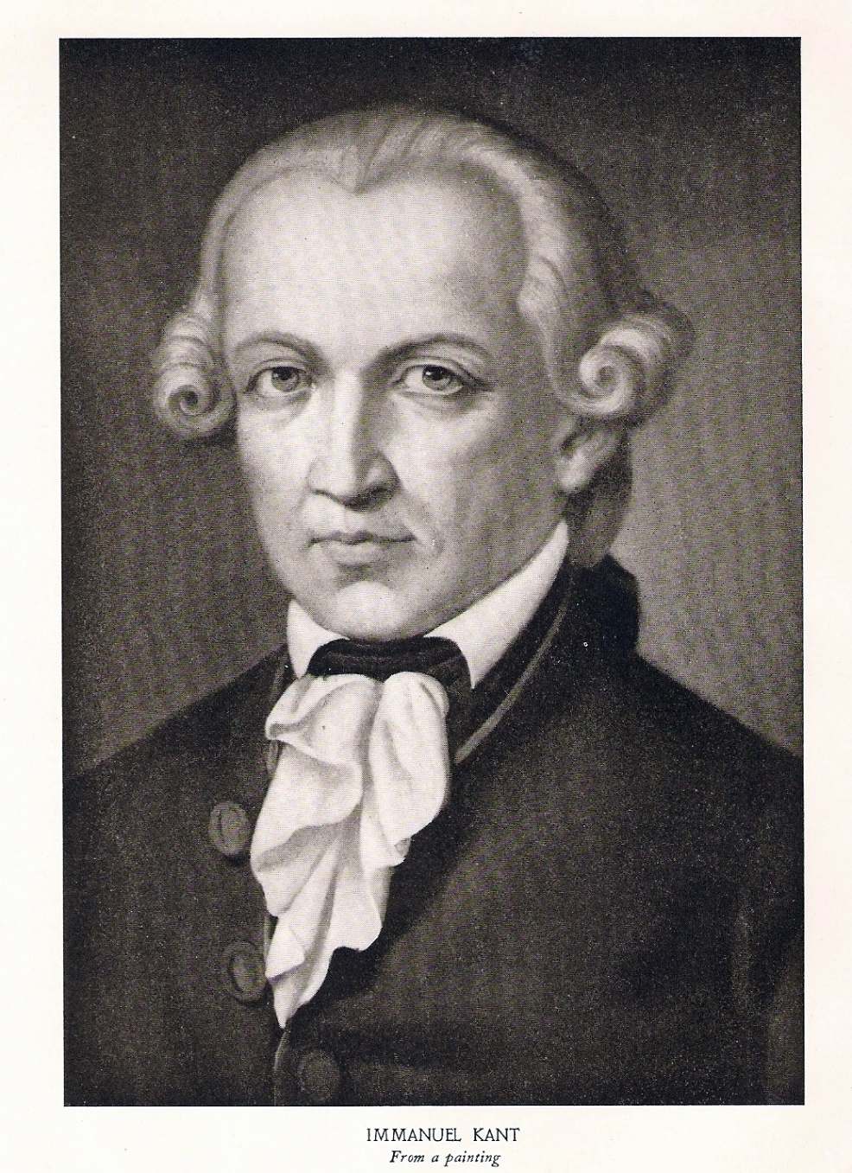
Immanuel Kant
Most ethics reason from a human perspective, either attributing values to humans only or letting humans be the only source of value
Kant introduced “moral agent” and “universality”: If a rule applies to one moral agent, it applies to any
Do not unto others …

Slide 6
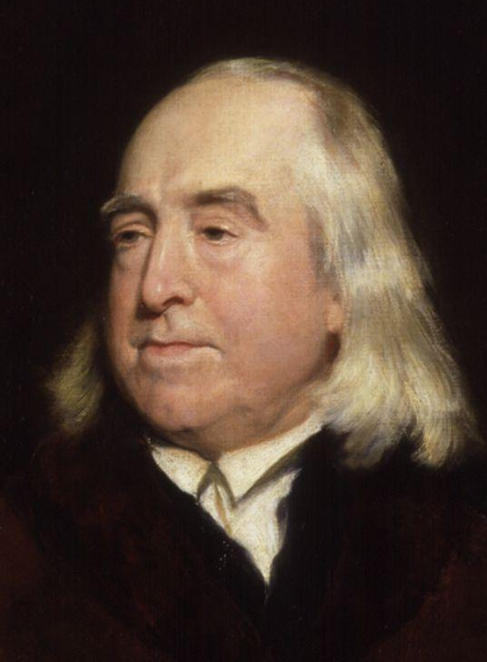
Naturalism
Naturalist moral philosophy extends moral rights to other species
Poor
Females
Non-whites
Higher animals
Sentient beings
Living beings
All beings

Slide 7
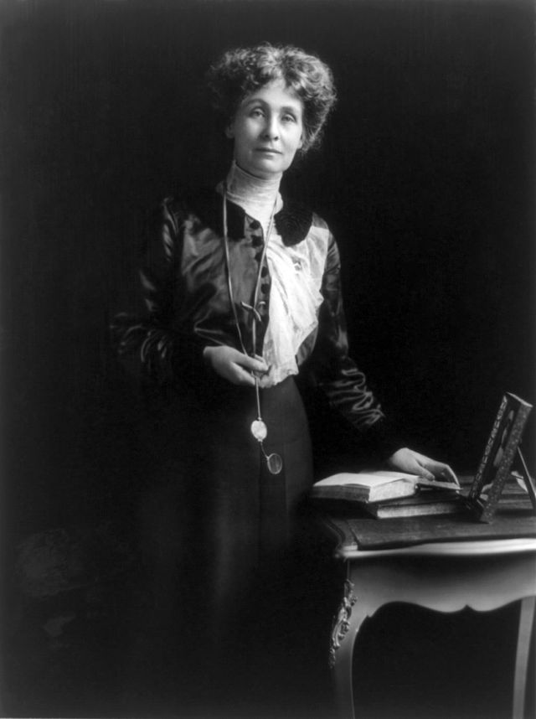
Naturalism
Naturalist moral philosophy extends moral rights to other species
Poor
Females
Non-whites
Higher animals
Sentient beings
Living beings
All beings

Slide 8
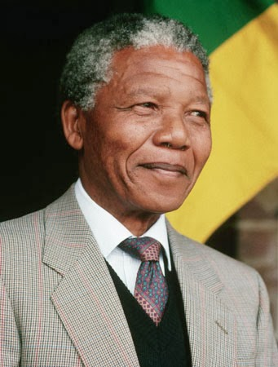
Naturalism
Naturalist moral philosophy extends moral rights to other species
Poor
Females
Non-whites
Higher animals
Sentient beings
Living beings
All beings

Slide 9
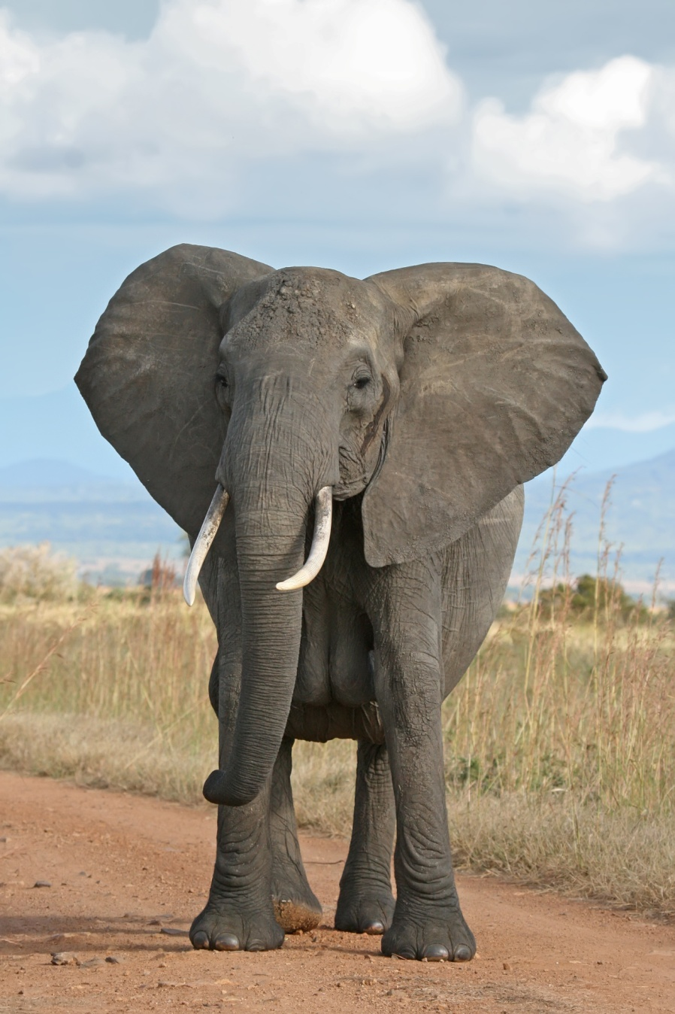
Naturalism
Naturalist moral philosophy extends moral rights to other species
Poor
Females
Non-whites
Higher animals
Sentient beings
Living beings
All beings

Slide 10
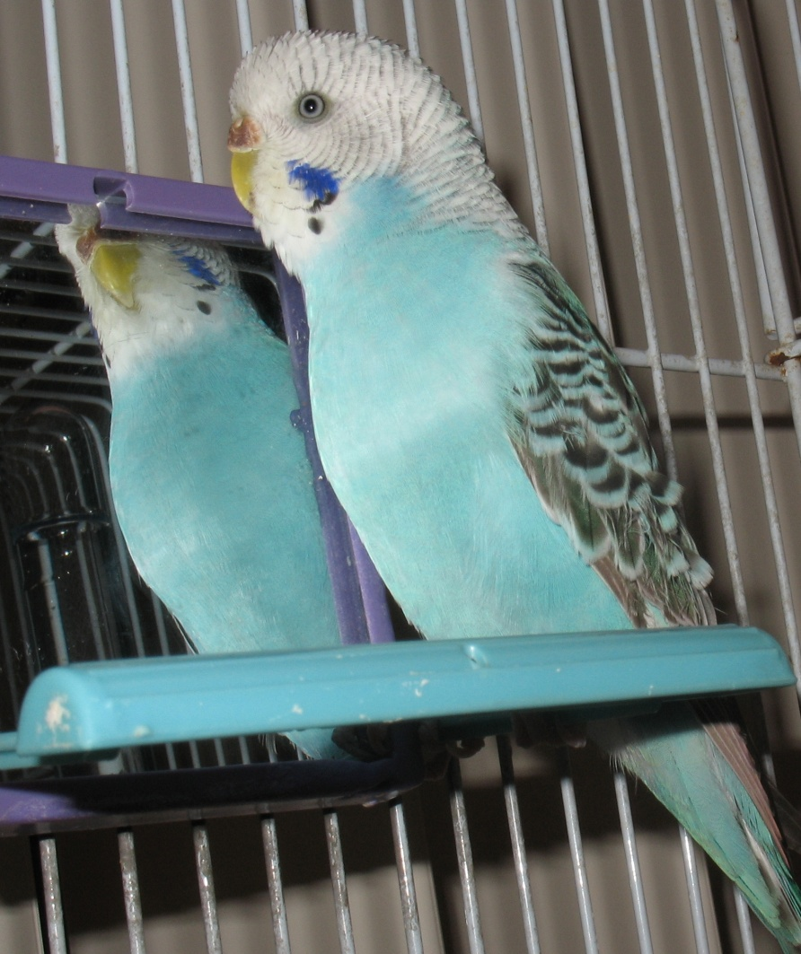
Naturalism
Naturalist moral philosophy extends moral rights to other species
Poor
Females
Non-whites
Higher animals
Sentient beings
Living beings
Beings in existence

Slide 11

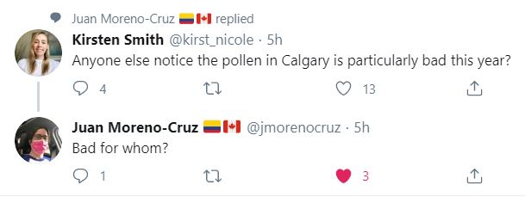
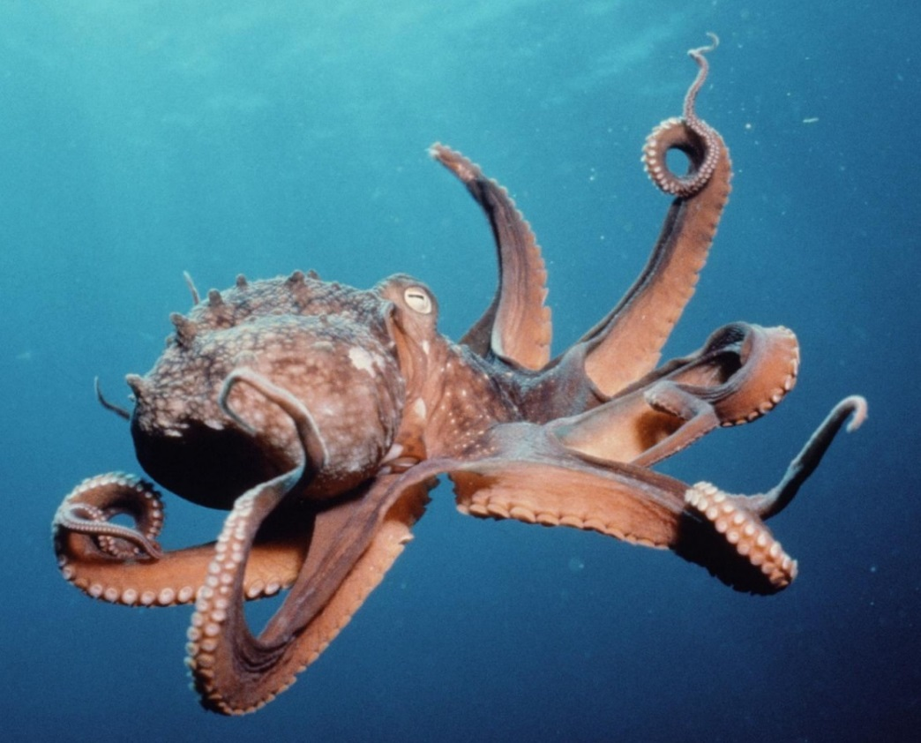
Naturalism
Naturalist moral philosophy extends moral rights to other species
Poor
Females
Non-whites
Higher animals
Sentient beings
Living beings
All beings

Slide 12
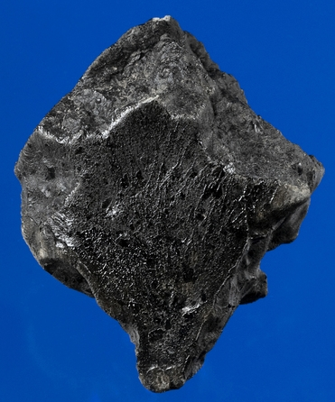
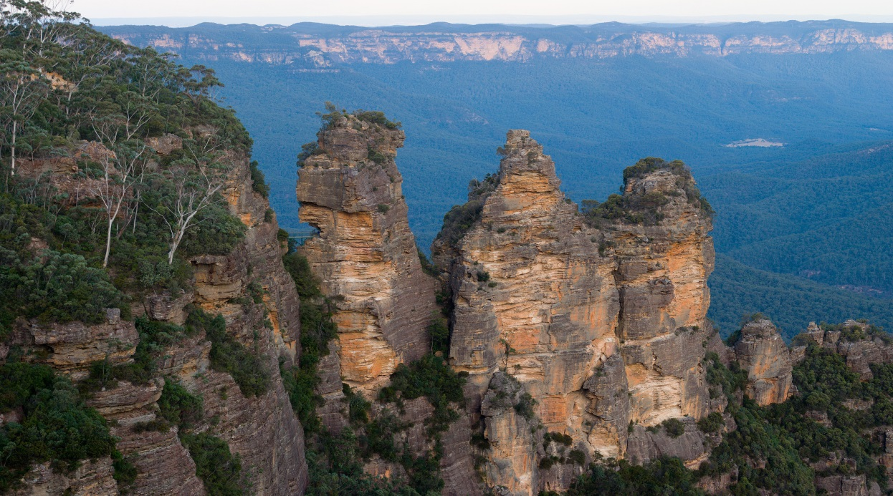
Naturalism
Naturalist moral philosophy extends moral rights to other species
Poor
Females
Non-whites
Higher animals
Sentient beings
Living beings
All beings

Slide 13
Outline
Ethical foundations of social choice
Naturalist moral philosophy
Humanist moral philosophy
Libertarianism
Utilitarianism
Sustainability

Slide 14
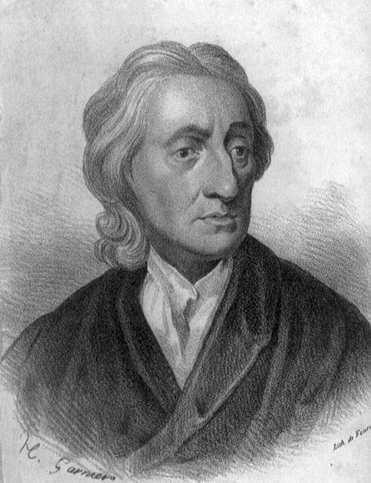
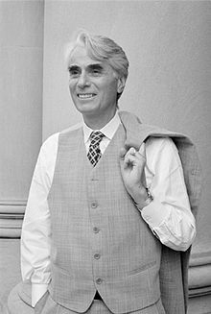
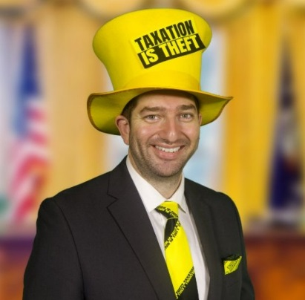
Libertarianism
Individual rights and liberties
Primacy of process
Locke: Original property is just if acquired through labour
Argued against absolute monarchy
Nozick: Property is just if obtained through free consent
No concept of consequential justice
No role for distributional policy
Government has a role in:
Unjust holdings
Open access, common property
Externalities

Slide 15
Outline
Ethical foundations of social choice
Naturalist moral philosophy
Humanist moral philosophy
Libertarianism
Utilitarianism
Roots and principles
Welfare theorems and functions
Critiques
Sustainability

Slide 16

Utilitarianism
Individual pleasure, happiness, well-being
Individual utility and social welfare
Primacy of outcome
No concept of procedural justice
Government policy should strive for the greatest good for the greatest number
Narrow: utility is individual, human utility; welfare is sum of utilities
Broad: utility includes altruism and non-humans; welfare is some function of utilitities

Slide 17
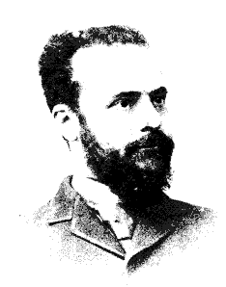
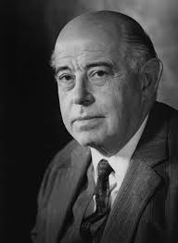
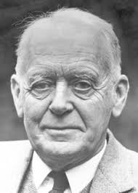
Welfare theory
Situation A is Pareto superior to Situation B if at least one is better off and none are worse off
A situation is Pareto optimal, or efficient, if there are no Pareto improvements
Situation A is a potential Pareto improvement to situation B if it is Pareto superior after transfers, that is, if the winners compensate the losers
Jargon: it satisfies the Kaldor-Hicks criterion

Slide 18
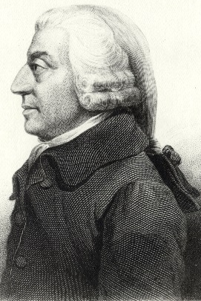
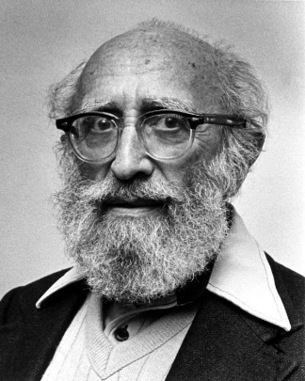
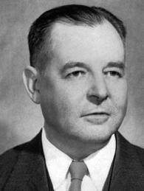
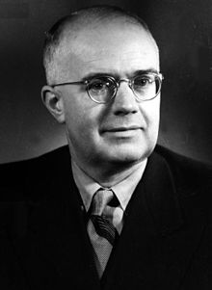
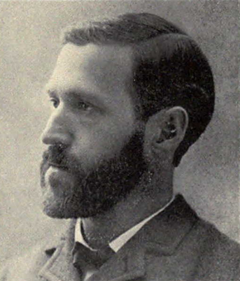
Welfare theorems
A perfectly competitive equilibrium is a Pareto optimum
First fundamental welfare theorem
Any Pareto optimum can be achieved as a perfectly competitive equilibrium with the appropriate reallocation of resources
Second fundamental welfare theorem

Slide 19
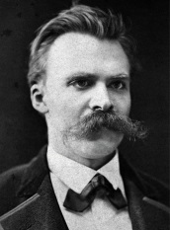
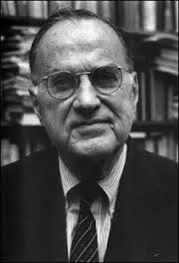
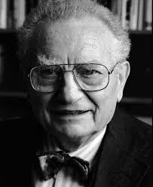
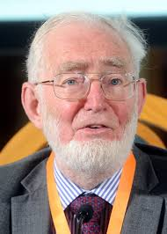
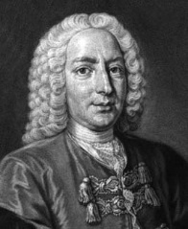
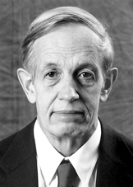
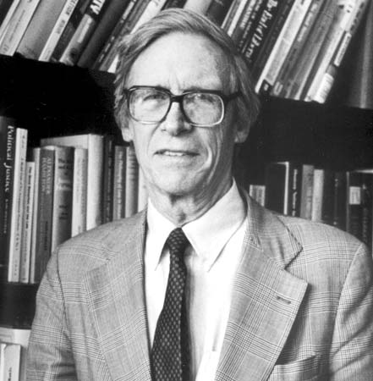
Social welfare

Slide 20
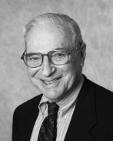
Arrow
If there are 2 agents and 3 goods (or 3 agents and 2 goods) and utility cannot be compared, then individual preferences / utility functions cannot be aggregated to social preferences / a social welfare function that satisfies
Non-dictatorship
Non-imposition
Unrestricted domain
Independence of irrelevant alternatives
Monotonicity
(ditto if monotonicity and non-imposition are replaced by unanimity)

Slide 21
Outline
Ethical foundations of social choice
Naturalist moral philosophy
Humanist moral philosophy
Libertarianism
Utilitarianism
Roots and principles
Welfare theorems and functions
Critiques
Sustainability

Slide 22
Rawls
Justice is what everyone would agree to if all were free, rational and impartial: veil of ignorance
Skills
Position
Attitude
Fundamental principles
Maximum liberty, no infringement on other’s liberties
Resource difference only if
It makes everyone better off
Attached to position

Slide 23
Rawls (2)
Often reinterpreted in a utilitarian way: maximise the utility of the worst off
Rawls may have disagreed with that
Holds also intertemporally (or so some argue)

Slide 24
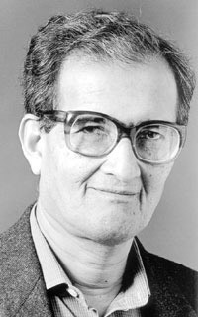
Other criticism
Naturalism, libertarianism
Utility is too narrow, there is more than goods and services, e.g., freedom
Besides individual utility, there is altruism, responsibility
Agency
Utilitarianism may lead to repugnant conclusions

Slide 25
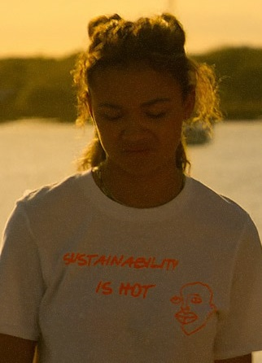
Outline
Ethical foundations of social choice
Sustainability
Roots
Weak sustainability
Strong sustainability
A social construct

Slide 26

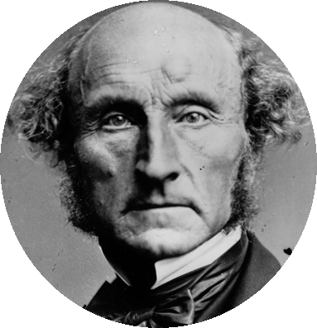
Sustainability
John Stuart Mill (1857)
If the earth must lose that great portion of its pleasantness which it owes to things that the unlimited increases of wealth and population would extirpate from it, for the mere purpose of enabling it to support a larger, but not a happier or better population, I sincerely hope, for the sake of posterity, that they will be content to be stationary long before necessity compels them to it.

Slide 27
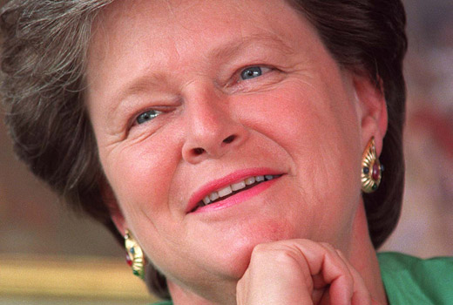
Sustainability -2
Bruntland report (WCED, 1987)
Sustainable development is development that meets the needs of the present without compromising the ability of future generations to meet their own needs
Wonderful, but what does this mean?

Slide 28
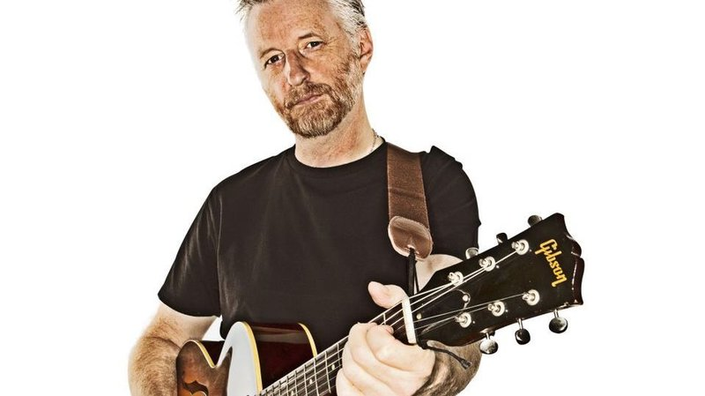
Definitions?
The temptation.
To take the precious things we have apart.
To see how they work.
Must be resisted for they never fit together again.

Slide 29
Sustainability =
Weak sustainability
Non-declining utility
Non-declining production opportunities
Non-declining yields of resource services
Strong sustainability
Non-declining natural capital stocks
Ecosystem stability and resilience
A social construct
All that, plus efficiency and equity

Slide 30
Outline
Ethical foundations of social choice
Sustainability
Roots
Weak sustainability
Strong sustainability
A social construct
Sustainable development is development that meets the needs of the present without compromising the ability of future generations to meet their own needs

Slide 31
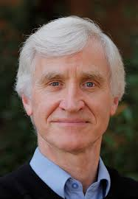
Non-declining utility
Pezzey: utility should not fall
Hartwick: consumption should not fall

Slide 32
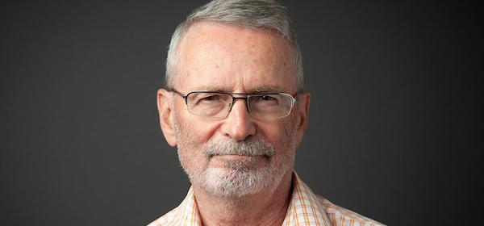
How much must be saved?
The Hartwick Rule (1977)
A constant level of consumption can be maintained perpetually from an environmental endowment if all the scarcity rents (net price, profit) from resource extraction are invested in other capital
i.e. keep total principal intact, live off service flow alone
Notes:
So how much must be saved for sustainability? …
…
This is intuitive because it means we maintain the stock of capital. If you’re running down natural capital stocks, such as oil reserves, you must be building up some other capital stocks (schools, roads, institutions, IP, …) at the same rate in order to compensate.
Otherwise, you’re like someone with a fortune invested who is living off not only the interest but also some of the principal.

Slide 33
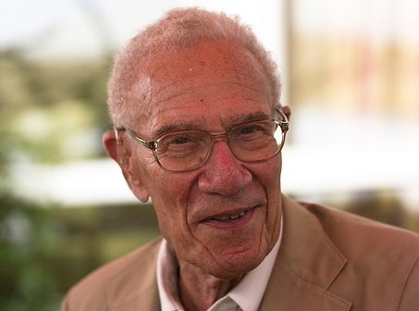
Non-declining utility
Pezzey: utility should not fall
Hartwick: consumption should not fall
Solow: consumption should be constant
Whose utility, consumption?
What time scale?
Substitution is allowed: Weak sustainability
What is utility, consumption?

Slide 34
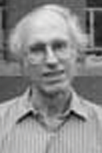
Non-declining production opportunities
Solow, Page
Q = Q(L, K_{H}, K_{N})
No assumption about what is consumption, utility
Production for whom?
What is production?
What time scale?
Substitution is allowed

Slide 35
Outline
Ethical foundations of social choice
Sustainability
Roots
Weak sustainability
Strong sustainability
A social construct
Sustainable development is development that meets the needs of the present without compromising the ability of future generations to meet their own needs

Slide 36
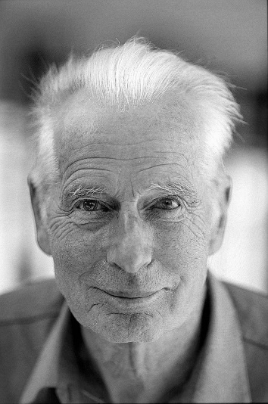
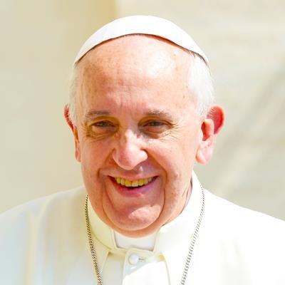
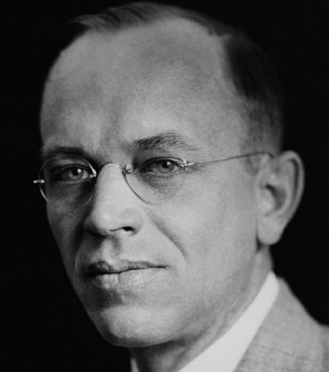
Non-declining natural capital stocks
Strong sustainability: no substitution is allowed
Taken literally, this stops everything
In practice, some substitution and compensation must be allowed, but how much?
Is spatial substitution allowed? Or, at what spatial scale?
What stocks are maintained? Habitats, species, genes?
What to do with viruses and pests?

Slide 37
Non-declining yields of resource services
Back to an anthropocentric viewpoint, or not? Depends on services to whom? To Homo Sapiens or to other species as well?
What are services?
What time scale?
What spatial scale?
Substitution is allowed, as long as the service is generated

Slide 38
Ecosystem stability and resilience
An ecocentric viewpoint, or is it? Is stability measured as stably serving human needs?
What is stability, resilience?
What spatial and temporal scale?
Are ecosystems naturally stable?
Beyond a point, no substitution of man-made stocks and activities for natural stocks and processes

Slide 39
Outline
Ethical foundations of social choice
Sustainability
Roots
Weak sustainability
Strong sustainability
A social construct
Sustainable development is development that meets the needs of the present without compromising the ability of future generations to meet their own needs

Slide 40
A social construct
Sustainability is, of course, defined as society would like to define it
There is no objective definition possible
Some argue that if only we get the procedure of defining sustainability right ...
This is an example of a political goal jumping the environmental agenda

Slide 41
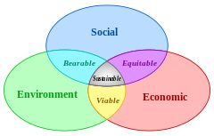
Sustainability, equity, and efficiency
The sustainability debate was first widened to include issues of distributional justice and economic efficiency
Whilst equity and efficiency are important goals in their own right, and cannot be separately assessed, there is little reason to blur the concept of sustainability ...
... except for political reasons

Slide 42
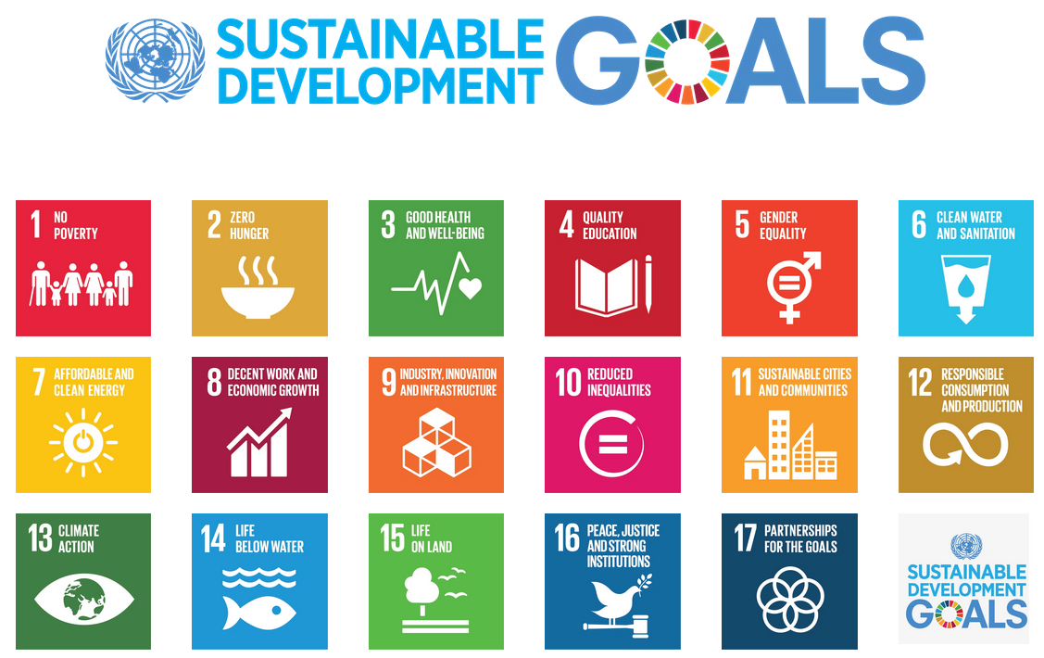

Slide 43
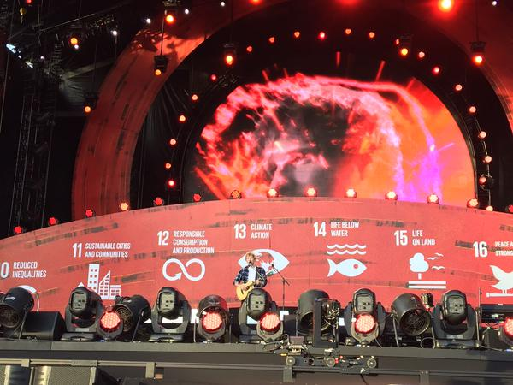

Slide 44
Sustainable development goals
End poverty in all its forms everywhere
End hunger, achieve food security and improved nutrition and promote sustainable agriculture
Ensure healthy live and promote well-being for all at all ages
Ensure inclusive and equitable quality education and promote lifelong learning opportunities for all
Achieve gender equality and empower all women and girls
Ensure availability and sustainable management of water and sanitation for all
Ensure access to affordable, reliable, sustainable and modern energy for all
Promote sustained, inclusive and sustainable economic growth, full and productive employment and decent work for all
Build resilient infrastructure, promote inclusive and sustainable industrialization and foster innovation

Slide 45
Sustainable development goals
Reduce inequality with and among countries
Make cities and human settlements inclusive, safe, resilient and sustainable
Ensure sustainable consumption and production patterns
Take urgent action to combat climate change and its impacts
Conserve and sustainably use the oceans, seas and marine resources for sustainable development
Protect, restore and promote sustainable use of terrestrial ecosystems, sustainably manage forests, combat desertification, and halt and reverse land degradation and biodiversity loss
Promote peaceful and inclusive societies for sustainable development, provide access to justice for all and build effective, accountable and inclusive institutions at all levels
Strengthen the means of implementation and revitalize the global partnership for sustainable development

Slide 46
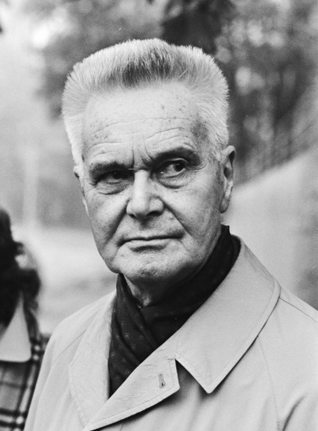
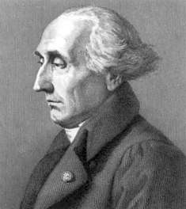
Tinbergen Rule
N problems require N policy instruments
This follows immediately from LaGrange’s work on optimization
Misdiagnosing multiple problems (social, environmental, economic) for a single one (sustainable) will thus get the solution wrong

